Slide 1




LOGO
UNIV/POLTEK
DIGITAL TALENT SCHOLARSHIP
2019
digitalent.kominfo.go.id

Slide 2
Persiapan Kelas:
Peserta telah mengetahui pemrograman Python dan mampu menggunakan Jupyter Notebooks.
Menggunakan dataset mtcars
Library python:
numpy
pandas
matplotlib.pyplot
mtcars.csv (https://www.kaggle.com/harika143/mtcars)

Slide 3
Metode kelas:
Kuliah Penjelasan: 100 menit
Praktek: 100 menit
Pola kegiatan:
Penjelasan teori kemudian diikuti dengan latihan menggunakan Python.
Presentasi powerpoint menjelaskan berapa lama latihan Python dilakukan.

Slide 4
Sesi 26 Pemodelan Linier: Regresi dan Korelasi
Big Data Analytics

Slide 5
Daftar Isi
Regresi – estimasi hubungan antar variabel
Regresi Linier
Pengujian asumsi
Regresi Non-linier
korelasi
Koefisien korelasi mengkuantifikasi kuatnya asosiasi antar variabel
Sensitivitas terhadap distribusi

Slide 6
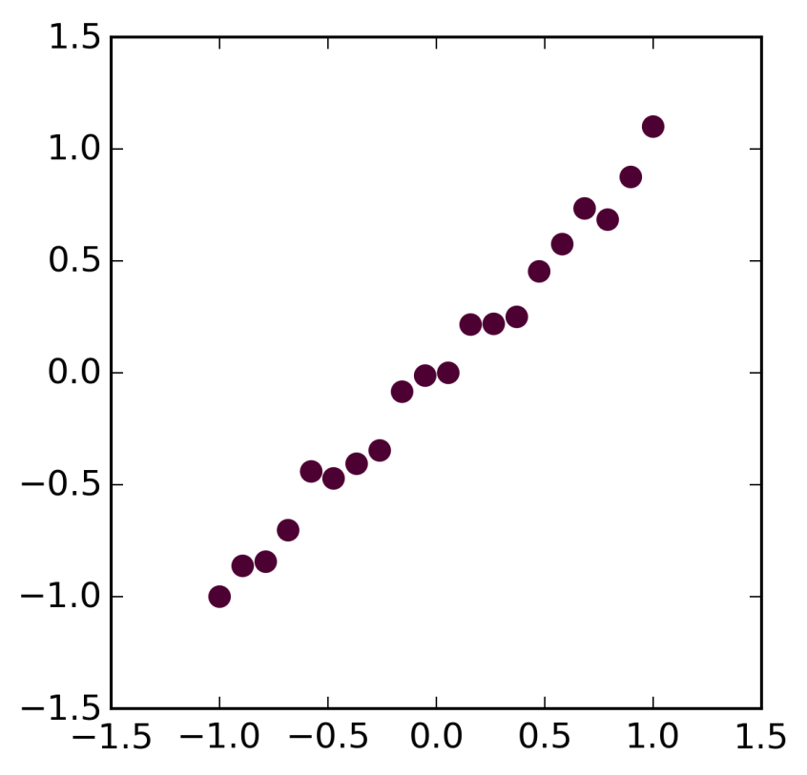
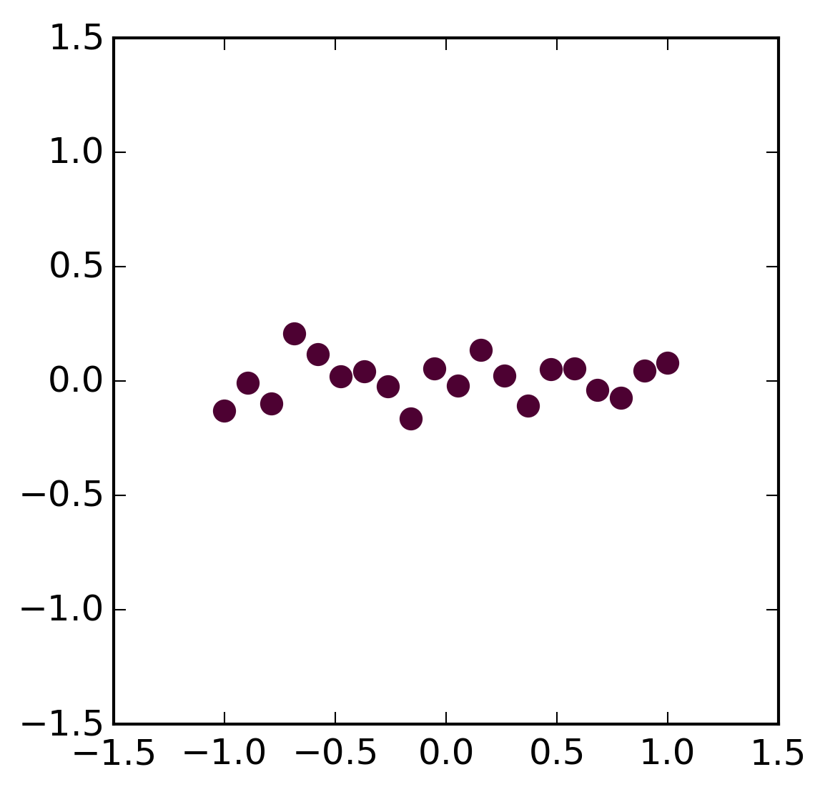
Hubungan antarvariabel
Terhubung
Tak Terhubung

Slide 7
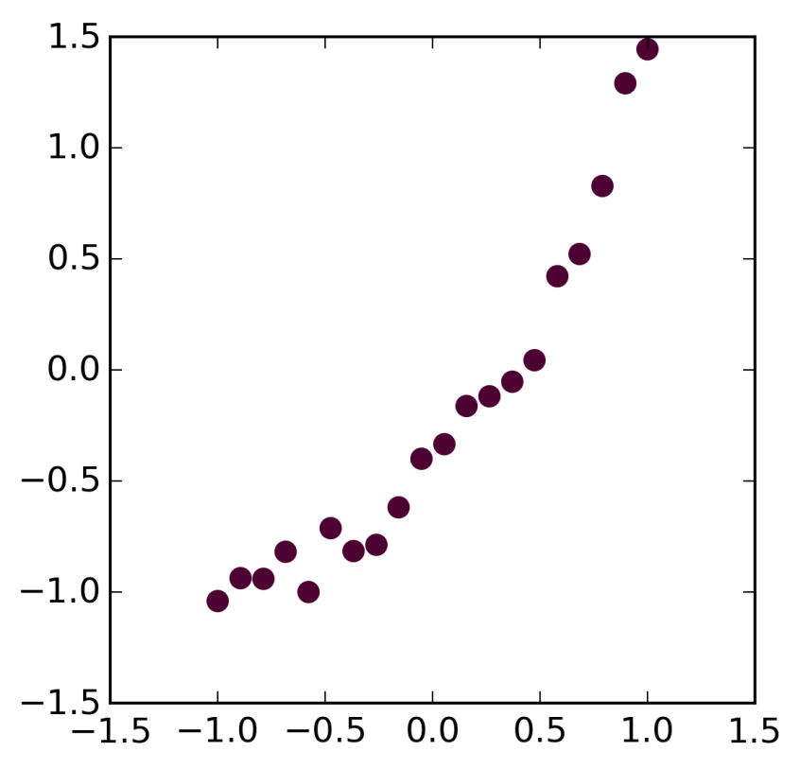
Hubungan antarvariabel
Terhubung Linier
Terhubung Non-linier
Terhubung Non-linier

Slide 8
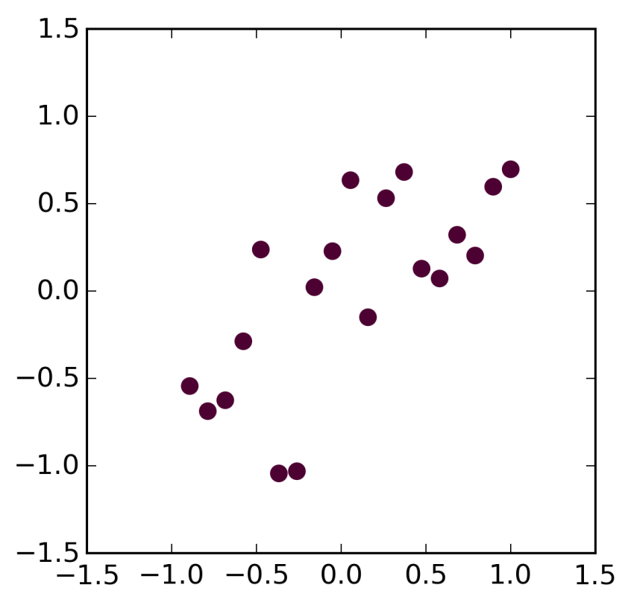
Hubungan antarvariabel
Linier, terhubung kuat
Linier, terhubung lemah

Slide 9
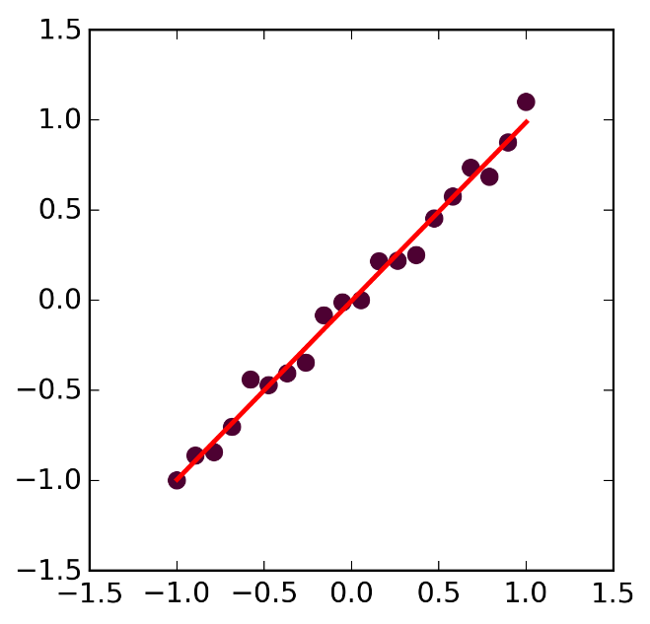
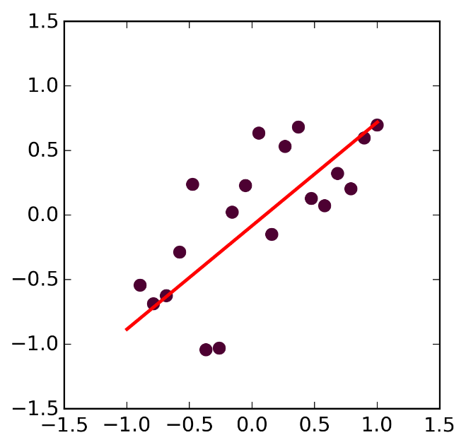
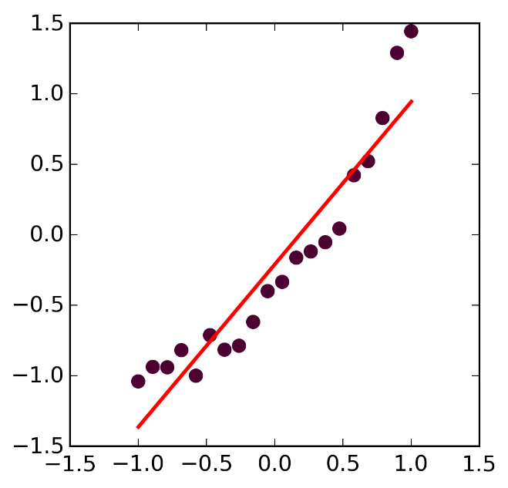
Regresi Linier
Linier, kuat
Linier, Lemah
Non-Linier

Slide 10
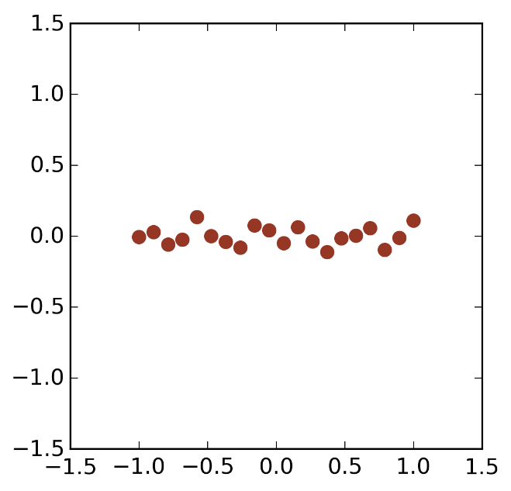
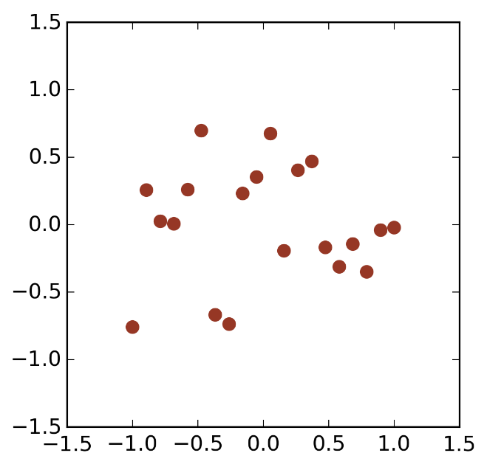
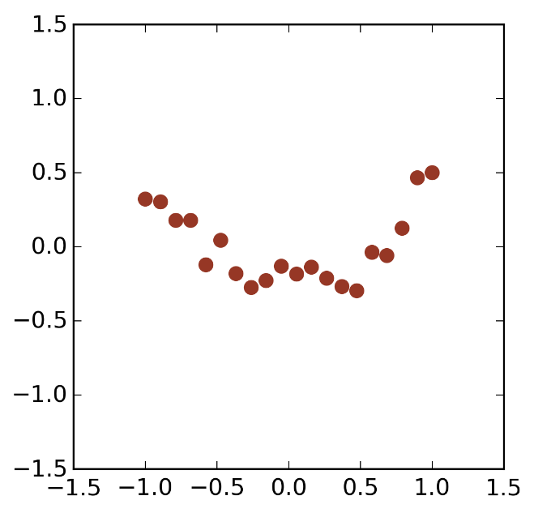
Regresi Linier - Residual
Linier, Kuat
Linier, Lemah
Non-Linier
Residuals
Residuals
Residuals
acak
acak - tersebar
berpola - tersebar

Slide 11
Model Regresi Linier
Slope
Variabel bebas
Intercept
Variabel terikat
Random Error
Komponen linier
Komponen random error

Slide 12
Asumsi-asumsi pada Regresi Linier
Hubungan antar variabel adalah linier.
Errors bersifat bebas, terdistribusi normal dengan nilai rata-rata nol dan varians yang konstan.

Slide 13
Asumsi-asumsi pada Regresi Linier
Linier
Non-Linier
Residuals
Residuals

Slide 14
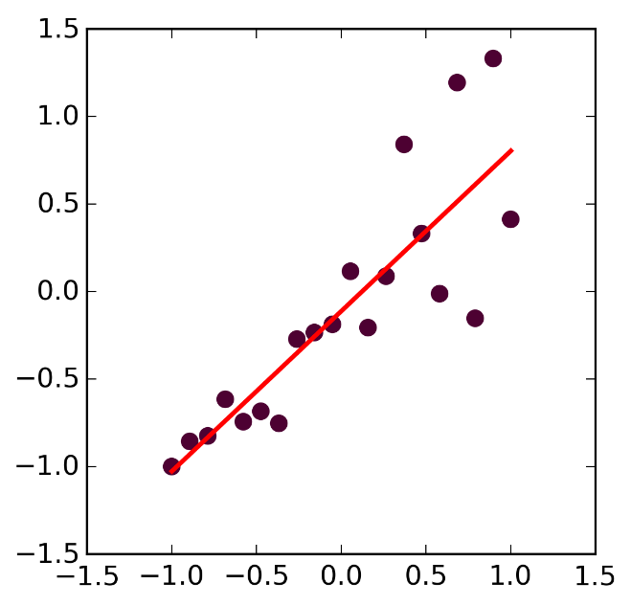
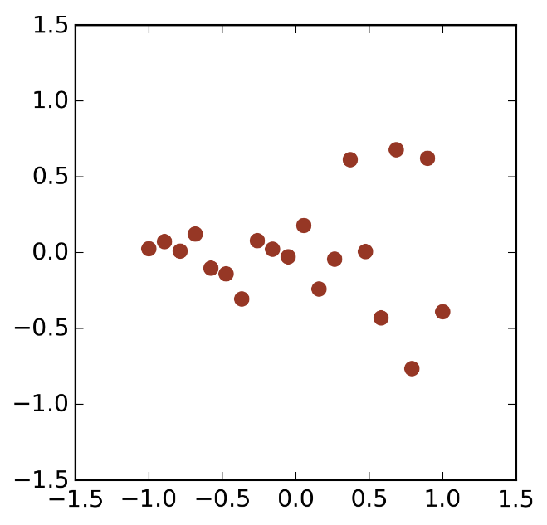
Asumsi-asumsi pada Regresi Linier
Varians konstan
Varians berubah-ubah
Residuals
Residuals

Slide 15
Model Regresi Linier
Slope
Variabel bebas
Intercept
Variabel terikat
Random Error
Komponen linier
Komponen random error

Slide 16
Regresi Linier – Estimasi fungsi garis
Estimasi
Intercept
Estimasi Slope
Estimasi Nilai Sampel
Variabel Bebas

Slide 17
Linier Regresi – Estimating the Line
Estimated Intercept
Estimated Slope
Estimated Value
Independent Variable

Slide 18
Metode Least Squares
Find slope and intercept given measurements X_{i},Y_{i}, i=1..N
that minimizes the sum of the squares of the residuals.

Slide 19
Least Squares Method
Find slope and intercept given measurements X_{i},Y_{i}, i=1..N
that minimizes the sum of the squares of the residuals.

Slide 20
Least Squares Method
Find slope and intercept given measurements X_{i},Y_{i}, i=1..N
that minimizes the sum of the squares of the residuals.

Slide 21
Linier Regresi in Python
import scipy.stats as stats
slope,intercept,r_value,p_value,std_err = stats.linregress(x,y)

Slide 22
Linier Regresi Example
Linier, Kuat
x=np.linspace(-1,1,points)
y=x+0.1*np.random.normal(size=points)
slope,intercept,r_value,p_value,std_err = stats.linregress(x,y)
y_line=slope*x+intercept
fig, (ax1) = plt.subplots(1,figsize=(4,4))
ax1.scatter(x,y,color='#4D0132',lw=0,s=60)
ax1.set_xlim([-1.5,1.5])
ax1.set_ylim([-1.5,1.5])
ax1.plot(x,y_line,color='red',lw=2)
fig.savefig('Linier.png')
fig, (ax1) = plt.subplots(1,figsize=(4,4))
ax1.scatter(x,y-y_line, color='#963725',lw=0,s=60)
ax1.set_xlim([-1.5,1.5])
ax1.set_ylim([-1.5,1.5])
fig.savefig('Linier-residuals.png')
Residuals

Slide 23
Linier Regresi Example
Linier, Lemah
x=np.linspace(-1,1,points)
y=x+0.4*np.random.normal(size=points)
slope,intercept,r_value,p_value,std_err = stats.linregress(x,y)
y_line=slope*x+intercept
fig, (ax1) = plt.subplots(1,figsize=(4,4))
ax1.scatter(x,y,color='#4D0132',lw=0,s=60)
ax1.set_xlim([-1.5,1.5])
ax1.set_ylim([-1.5,1.5])
ax1.plot(x,y_line,color='red',lw=2)
fig.savefig('Linier-Lemah.png')
fig, (ax1) = plt.subplots(1,figsize=(4,4))
ax1.scatter(x,y-y_line, color='#963725',lw=0,s=60)
ax1.set_xlim([-1.5,1.5])
ax1.set_ylim([-1.5,1.5])
fig.savefig('Linier-Lemah-residuals.png')
Residuals

Slide 24
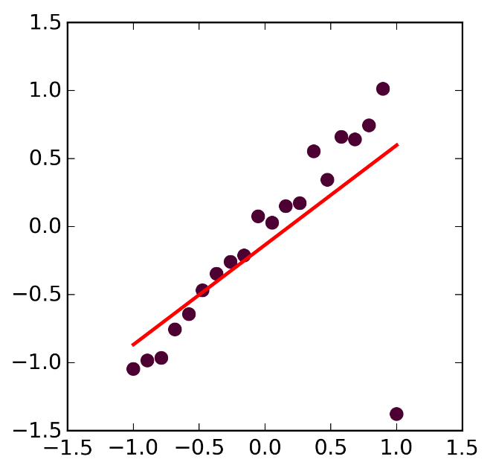
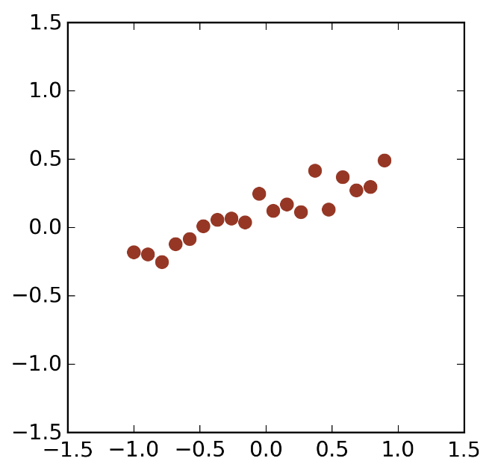
Linier Regresi Example
Outlier

Slide 25
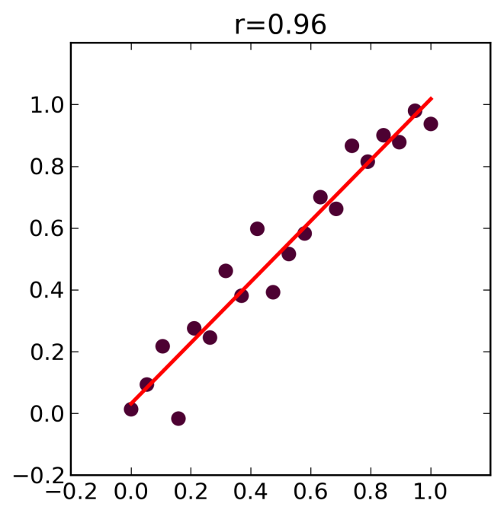
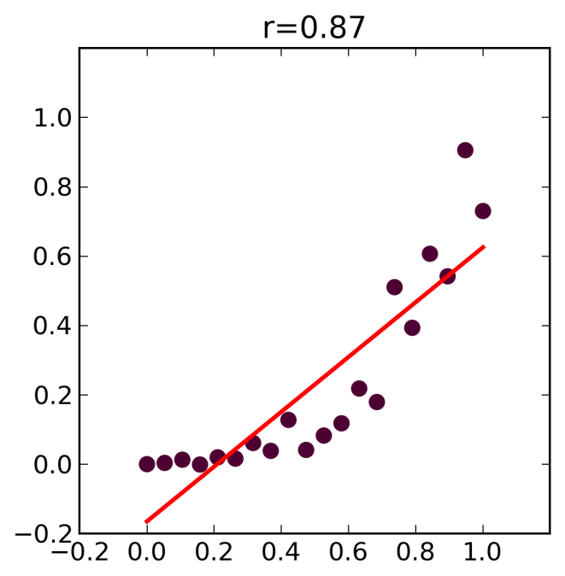
Regresi – Non-Linier data
Solution 1: Transformation
Solution 2: Non-Linier Regresi

Slide 26
koefisien korelasi
A measure of the korelasibetween the two variables
Quantifies the association strength
Pearson korelasicoefficient:

Slide 27
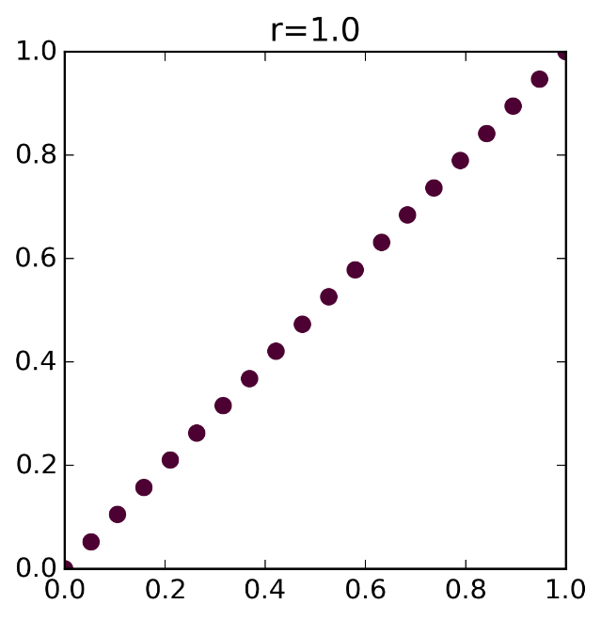
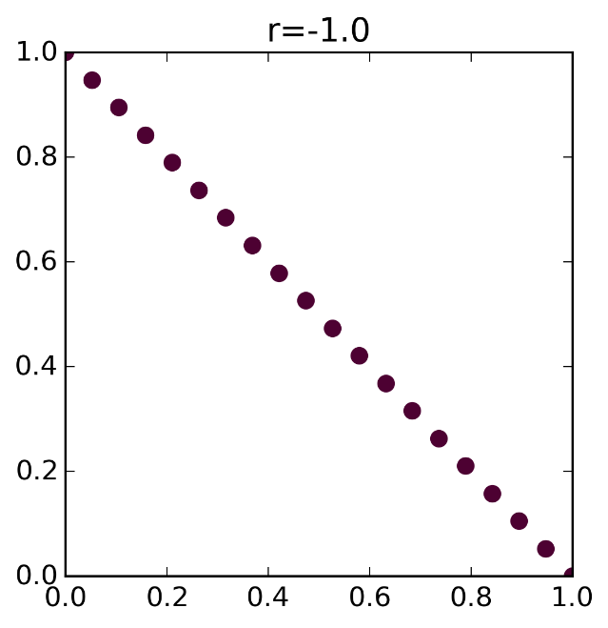
koefisien korelasi

Slide 28
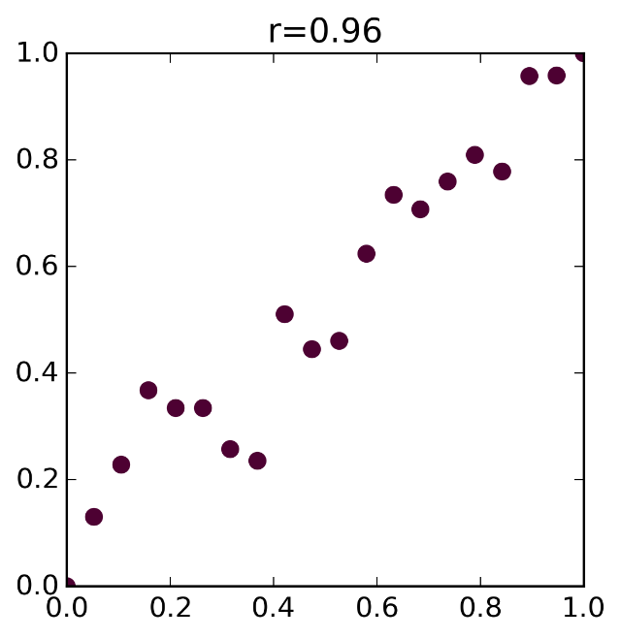
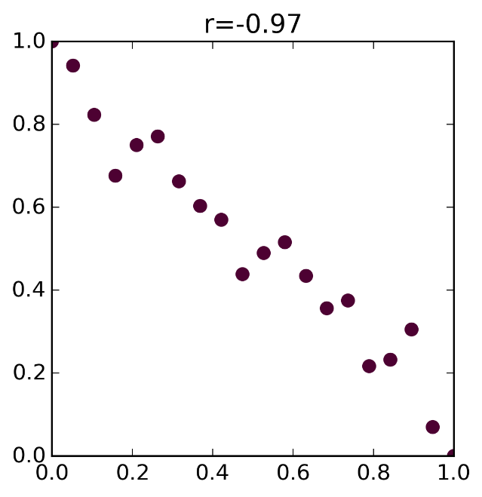
koefisien korelasi

Slide 29
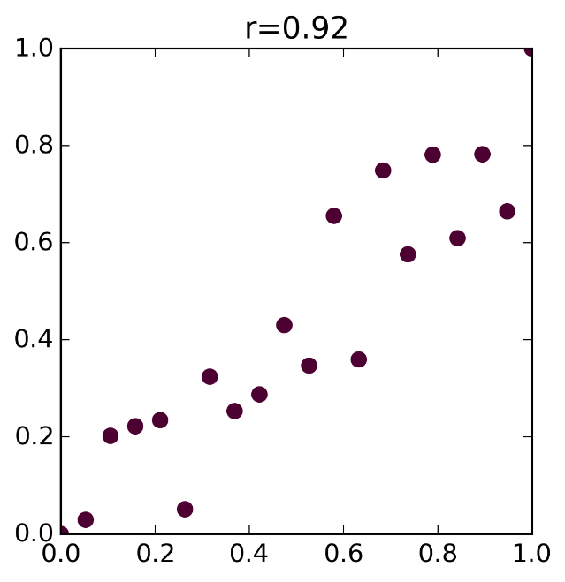
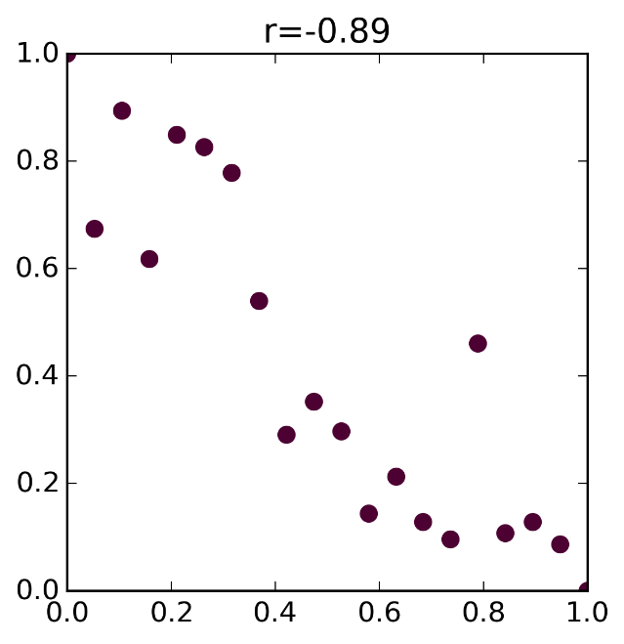
koefisien korelasi

Slide 30
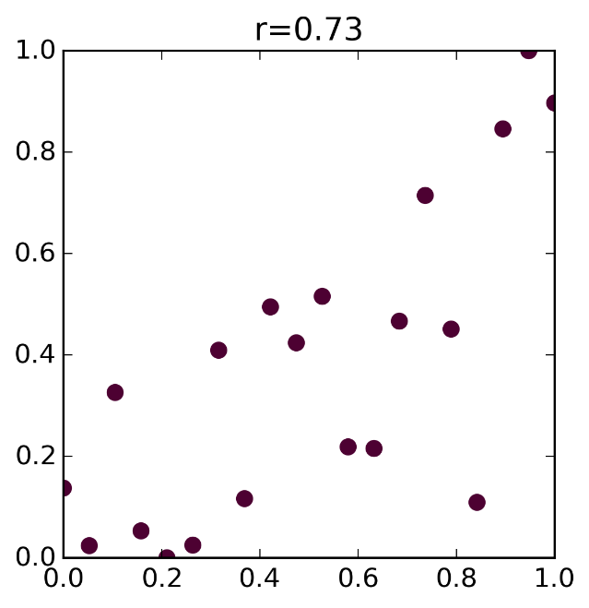
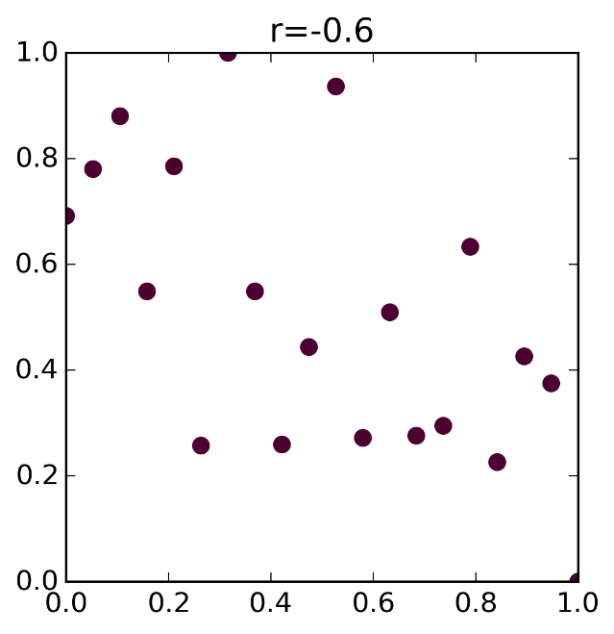
koefisien korelasi

Slide 31
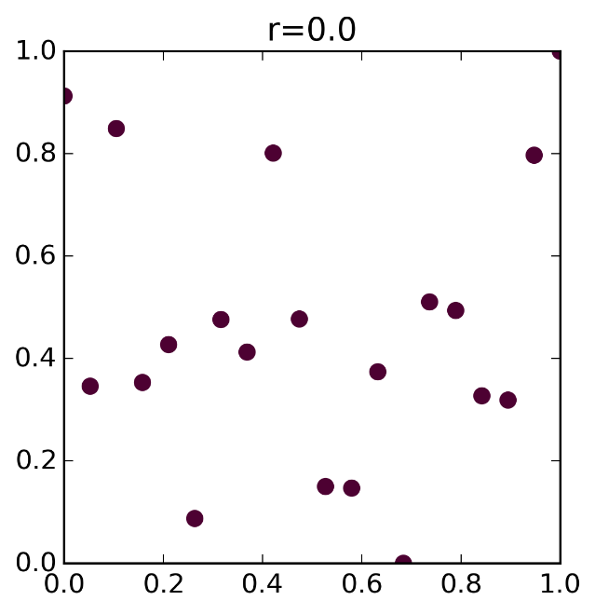
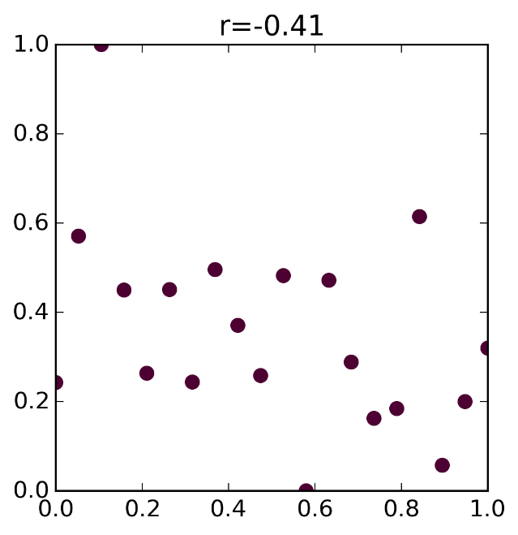
koefisien korelasi

Slide 32
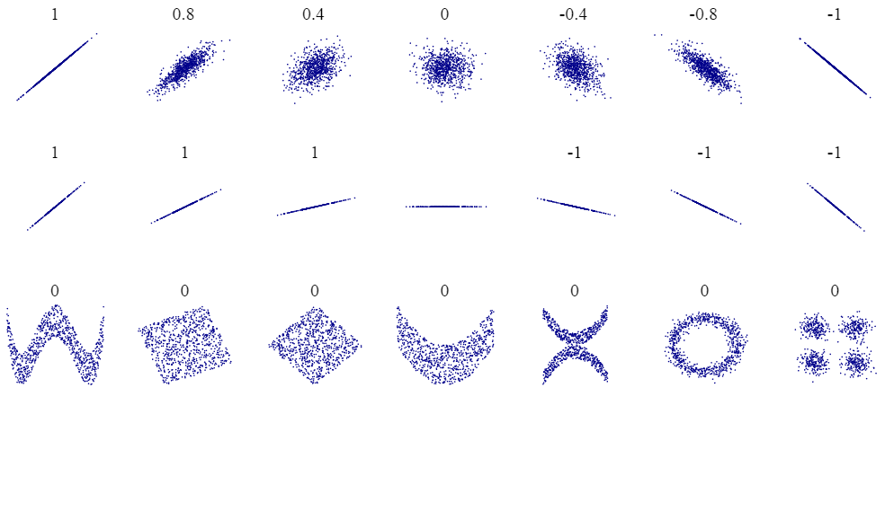
koefisien korelasi
Source: Wikipedia

Slide 33
Coefficient of Variation
Sample
Mean
Variance
Coefficient of Variation (CV)

Slide 34
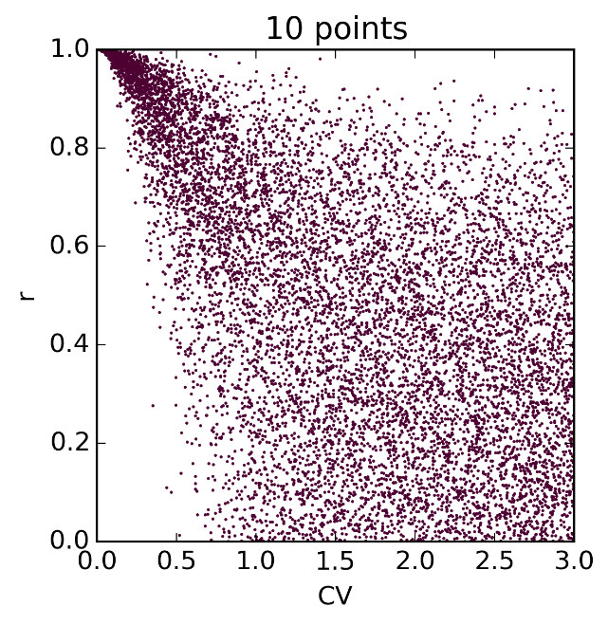
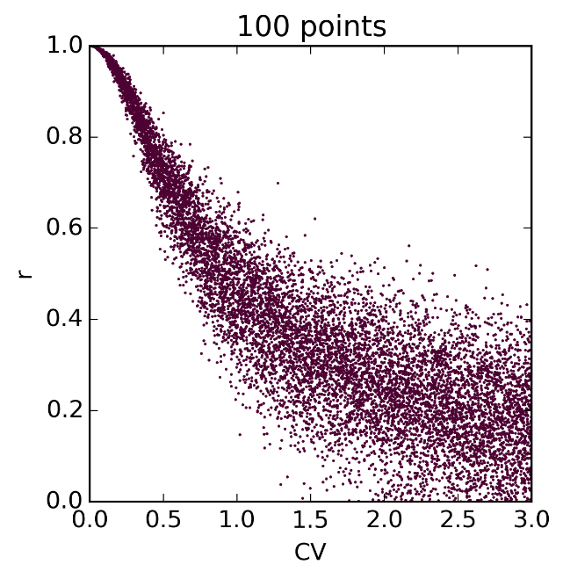
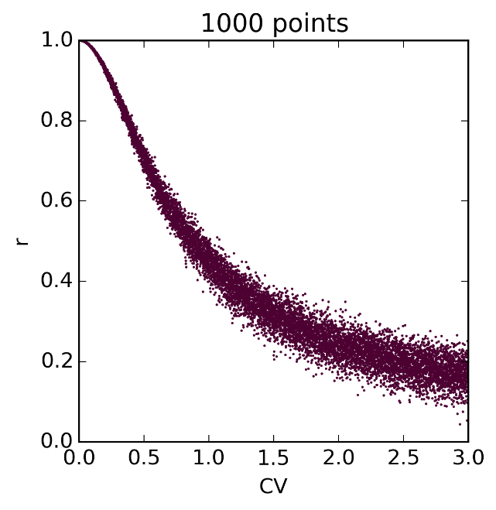
koefisien korelasiand CV
Uniform distribusi

Slide 35
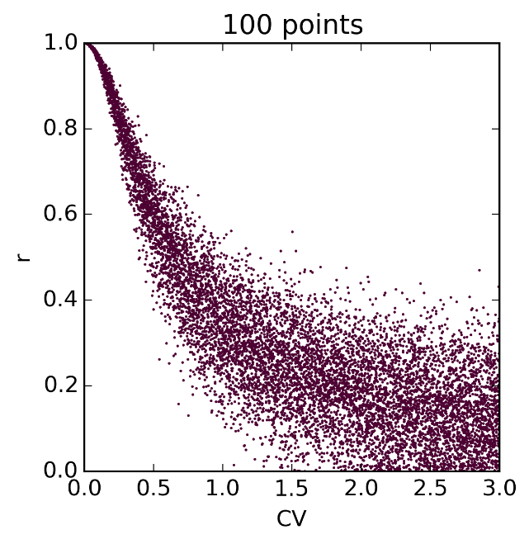
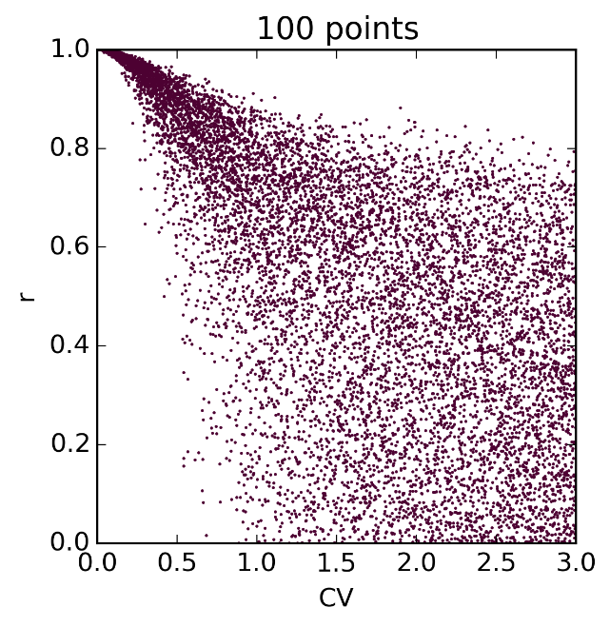
koefisien korelasiand CV
Uniform distribusi
Normal distribusi
Lognormal distribusi

Slide 36
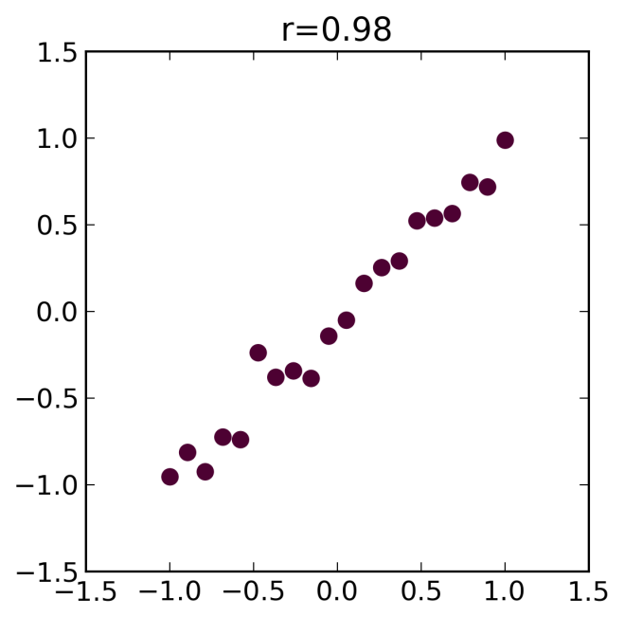
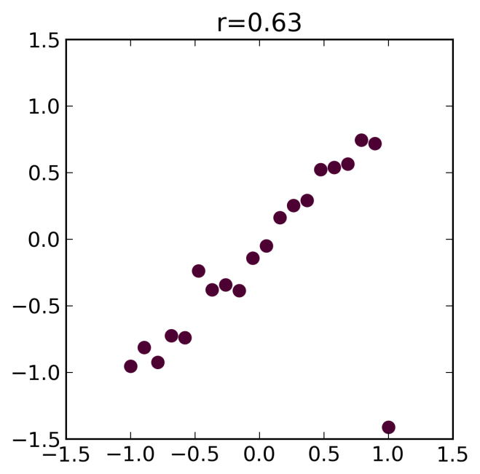
koefisien korelasi- Outliers
Outlier

Slide 37
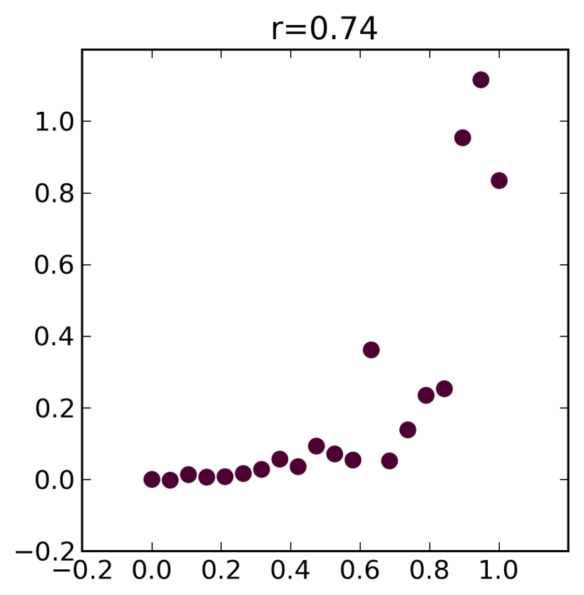
koefisien korelasi– Non-Linier
Solutions:
Transformation
Rank korelasi(Spearman, r=0.93)

Slide 38
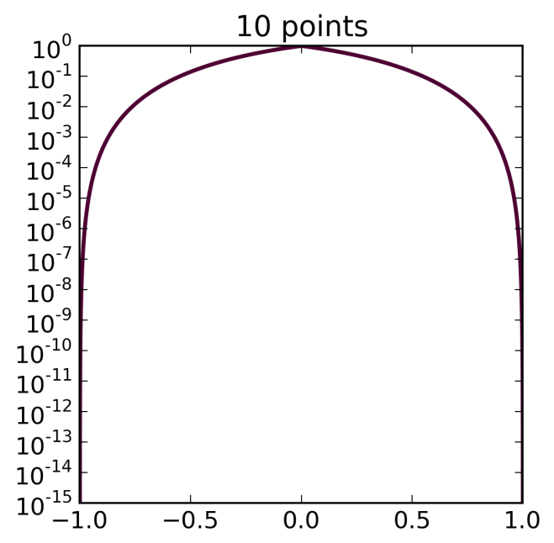
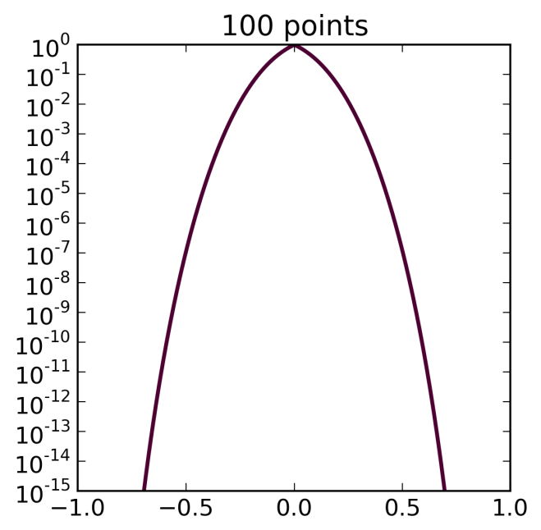
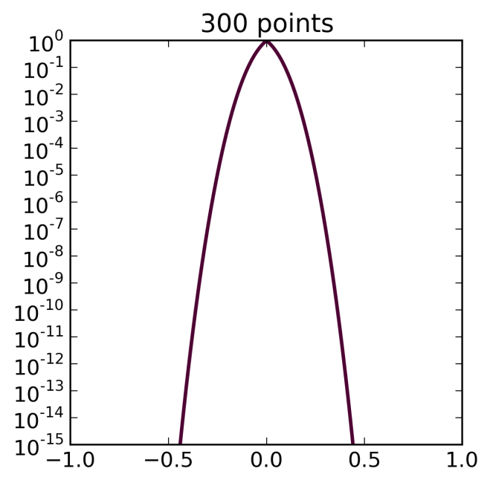
koefisien korelasiand p-value
Hypothesis: Is there a correlation?
p
p
p
r
r
r

Slide 39
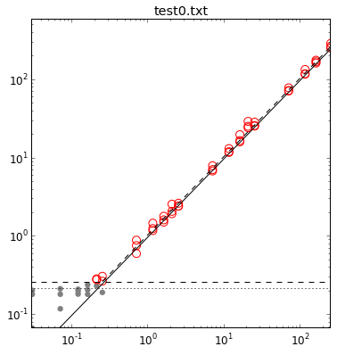
Application: Analytical Measurements
Measured Concentration
Theoretical Concentration

Slide 40
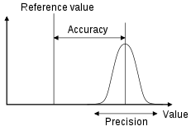
A Few Characteristics of Analytical Measurements
Accuracy: Closeness of agreement
between a test result and an accepted
reference value.
Precision: Closeness of agreement
between independent test results.
Robustness: Test precision given small, deliberate changes in test conditions (preanalytic delays, variations in storage temperature).
Lower limit of detection: The lowest amount of analyte that is statistically distinguishable from background or a negative control.
Limit of quantification: Lowest and highest concentrations of analyte that can be quantitatively determined with suitable precision and accuracy.
Linierity: The ability of the test to return values that are directly proportional to the concentration of the analyte in the sample.

Slide 41
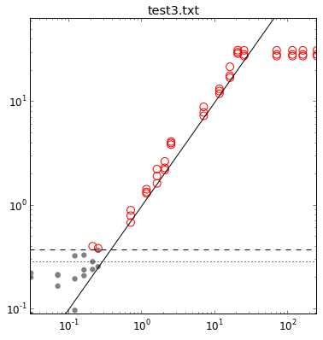
Limit of Detection and Linierity
Measured Concentration
Theoretical Concentration

Slide 42
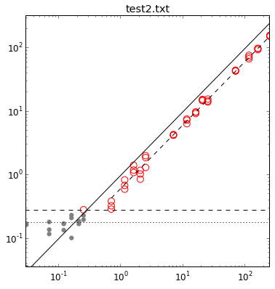
Precision and Accuracy
Measured Concentration
Measured Concentration
Theoretical Concentration
Theoretical Concentration

Slide 43
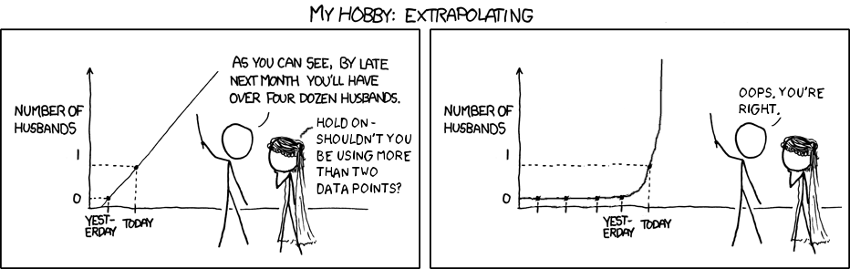
Summary - Regresi
Source: http://xkcdsw.com/content/img/2274.png

Slide 44
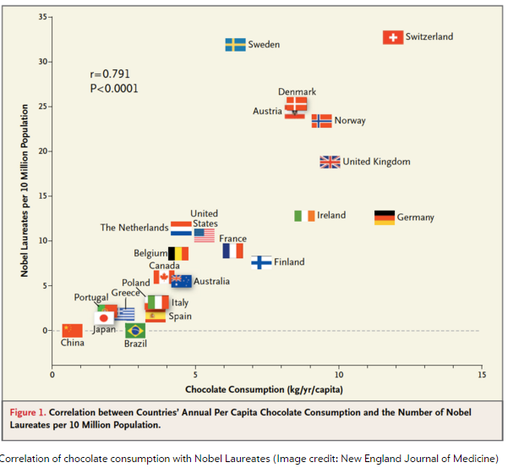
Summary - Correlation

Slide 45
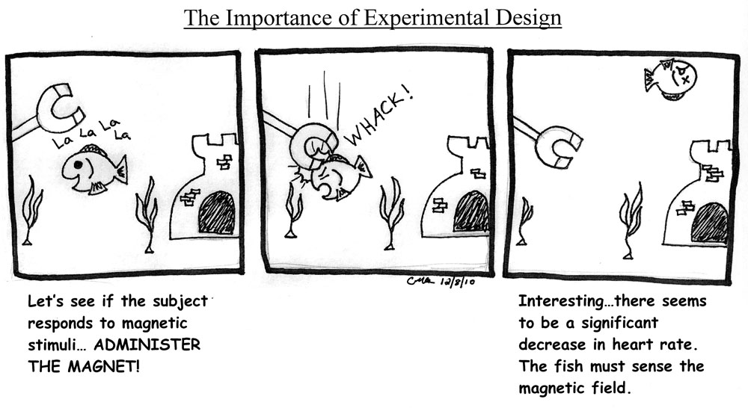
Next Lecture: Experimental Design & Analysis
Experimental Design by Christine Ambrosino
www.hawaii.edu/fishlab/Nearside.htm

Slide 46





IKUTI KAMI
digitalent.kominfo
digitalent.kominfo
DTS_kominfo
Digital Talent Scholarship 2019
Pusat Pengembangan Profesi dan Sertifikasi
Badan Penelitian dan Pengembangan SDM
Kementerian Komunikasi dan Informatika
Jl. Medan Merdeka Barat No. 9
(Gd. Belakang Lt. 4 - 5)
Jakarta Pusat, 10110
digitalent.kominfo.go.id

